Slide 1
Hybrid intelligent systems:
Neural expert systems and neuro-fuzzy systems
Introduction
Neural expert systems
Neuro-fuzzy systems
Computer Intelligence and Soft Computing

Slide 2
Introduction
A hybrid intelligent system is one that combines at least two intelligent technologies. For example, combining a neural network with a fuzzy system results in a hybrid neuro-fuzzy system.
The combination of probabilistic reasoning, fuzzy logic, neural networks and evolutionary computation form the hybrid intelligent system, capable of reasoning and learning in an uncertain and imprecise environment.
Computer Intelligence and Soft Computing

Slide 3
We use linguistic words when the available data is not precise enough to represent by numbers.
Words are used to provide tolerance for imprecision.
Soft computing exploits the tolerance for uncertainty and imprecision to achieve greater tractability and robustness, and lower the cost of solutions.
“Hard” computing fails to produce any solution of complex problems, soft computing is still capable of finding good solutions.
Computer Intelligence and Soft Computing

Slide 4
A hybrid intelligent system can be good or bad – it depends on which components constitute the hybrid.
So our goal is to select the right components for building a good hybrid system.
Computer Intelligence and Soft Computing

Slide 5
Neural expert systems
Expert systems rely on logical inferences and focus on modelling human knowledge and Reasoning Power.
Neural networks rely on parallel data processing and focus on modelling a human brain, particularly at its ability to learn.
Knowledge in a rule-based expert system is represented by IF-THEN production rules.
Knowledge in neural networks is stored as synaptic weights between neurons.
Computer Intelligence and Soft Computing

Slide 6
In expert systems, knowledge can be divided into individual rules and the user can see and understand the piece of knowledge applied by the system.
In neural networks, one cannot select a single synaptic weight as a discrete piece of knowledge.
Here knowledge is embedded in the entire network; it cannot be broken into individual pieces.
Computer Intelligence and Soft Computing

Slide 7
A hybrid system that combines a neural network and a rule-based expert system is called a neural expert system (or a connectionist expert system).
Computer Intelligence and Soft Computing

Slide 8
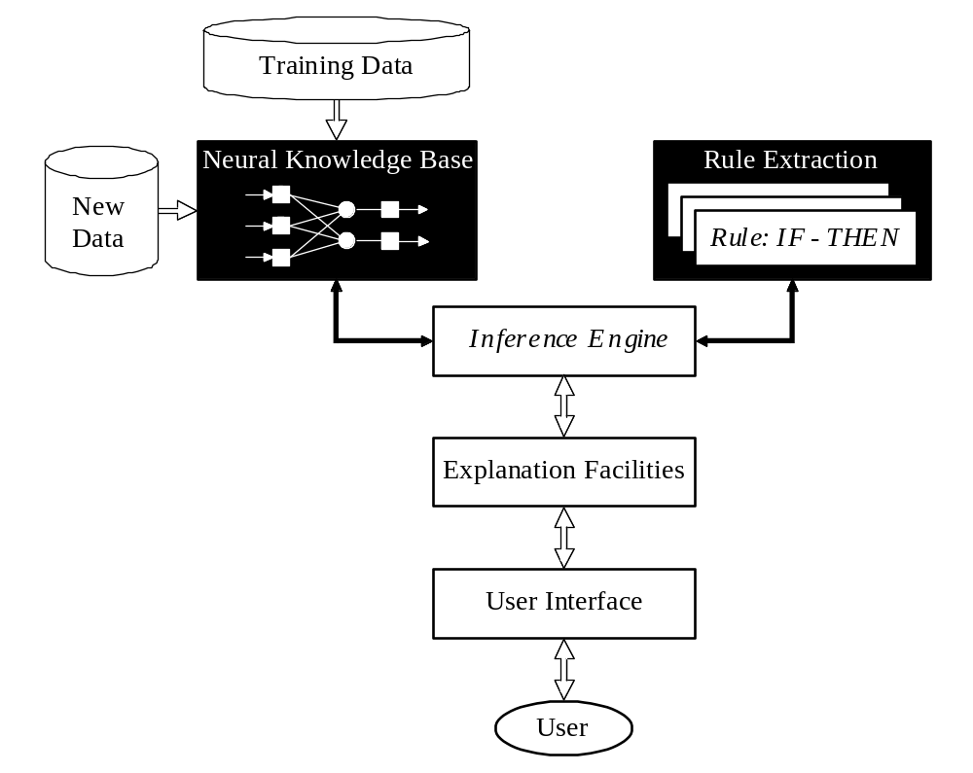
Basic structure of a neural expert system

Slide 9
The heart of a neural expert system is the inference engine. It controls the information flow in the system and initiates inference over the neural knowledge base. A neural inference engine also ensures approximate reasoning.
Computer Intelligence and Soft Computing

Slide 10
Approximate Reasoning
In a rule-based expert system, the inference engine compares the condition part of each rule with data given in the database. When the IF part of the rule matches the data in the database, the rule is fired and its THEN part is executed. The precise matching is required (inference engine cannot cope with noisy or incomplete data).
Neural expert systems use a trained neural network in place of the knowledge base. The input data does not have to precisely match the data that was used in network training. This ability is called approximate reasoning.
Computer Intelligence and Soft Computing

Slide 11
Rule extraction
Neurons in the network are connected by links, each of which has a numerical weight attached to it.
The weights in a trained neural network determine the strength or importance of the associated neuron inputs.
Computer Intelligence and Soft Computing

Slide 12
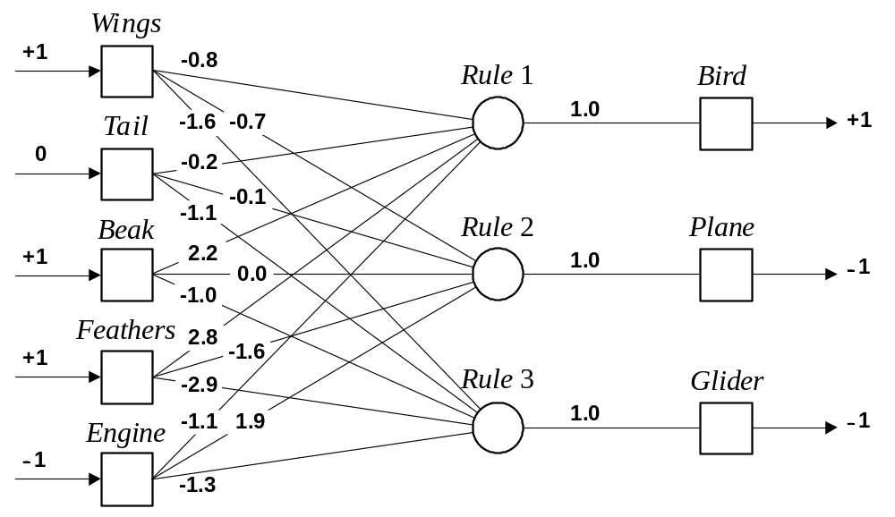
The neural knowledge base
Computer Intelligence and Soft Computing

Slide 13
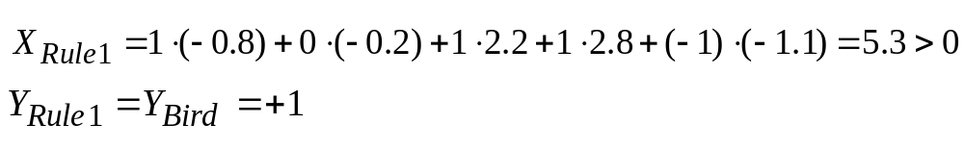
If we set each input of the input layer to either +1 (true), −1 (false), or 0 (unknown), we can give a semantic interpretation for the activation of any output neuron.
For example, if the object has Wings (+1), Beak (+1) and Feathers (+1), but does not have Engine (−1), then we can conclude that this object is Bird (+1):
Computer Intelligence and Soft Computing

Slide 14
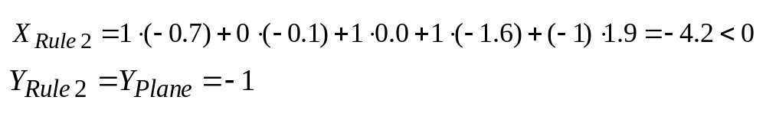
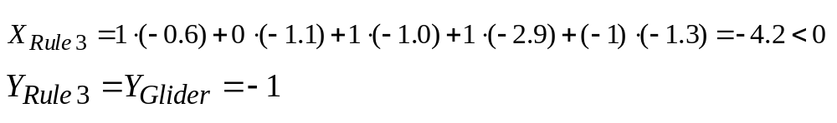
We can similarly conclude that this object is not Plane:
and not Glider:
Computer Intelligence and Soft Computing

Slide 15
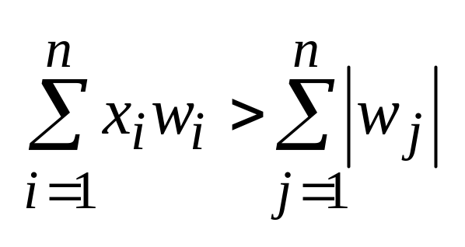
An inference can be made if the known net weighted input to a neuron is greater than the sum of the absolute values of the weights of the unknown inputs.
where i ∈ known, j ∉ known and n is the number of neuron inputs.
Computer Intelligence and Soft Computing

Slide 16
Example:
Enter initial value for the input Feathers: > +1
KNOWN = 1. (2.8) = 2.8 UNKNOWN = ⏐−0.8⏐ + ⏐−0.2⏐ + ⏐2.2⏐ + ⏐−1.1⏐ = 4.3 KNOWN < UNKNOWN
Enter initial value for the input Beak:
> +1
KNOWN = 1. (2.8) + 1. (2.2) = 5.0 UNKNOWN = ⏐−0.8⏐ + ⏐−0.2⏐ + ⏐−1.1⏐ = 2.1 KNOWN > UNKNOWN
CONCLUDE: Bird is TRUE
Computer Intelligence and Soft Computing

Slide 17
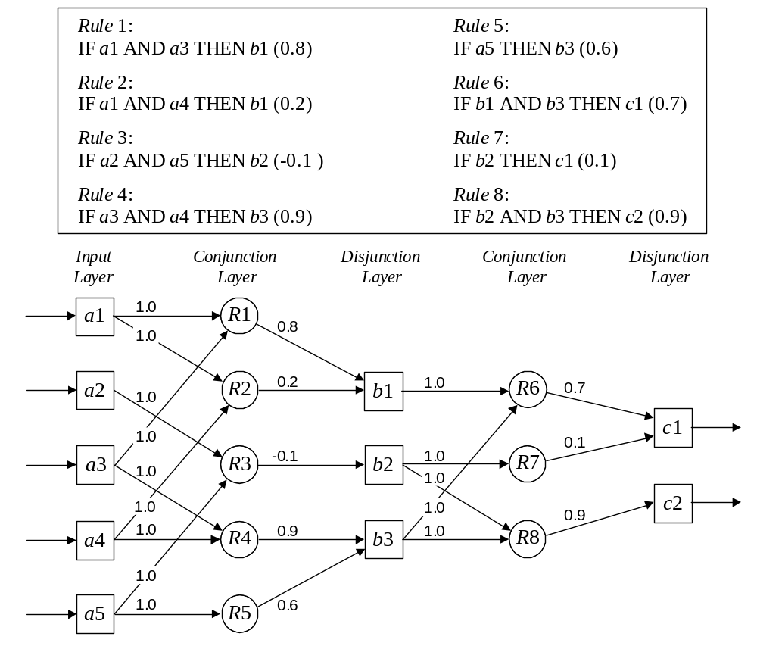
An example of a multi-layer knowledge base
Computer Intelligence and Soft Computing

Slide 18
Neuro-fuzzy systems
Fuzzy logic and neural networks are natural complementary tools in building intelligent systems.
While neural networks are low-level computational structures that perform well when dealing with raw data, fuzzy logic deals with reasoning on a higher level, using linguistic information acquired from domain experts.
However, fuzzy systems lack the ability to learn and cannot adjust themselves to a new environment. On the other hand, although neural networks can learn, they are opaque to the user.
Computer Intelligence and Soft Computing

Slide 19
Integrated neuro-fuzzy systems can combine the parallel computation and learning abilities of neural networks with the human-like knowledge representation and explanation abilities of fuzzy systems.
Computer Intelligence and Soft Computing

Slide 20
A neuro-fuzzy system is a neural network which is functionally equivalent to a fuzzy inference model.
It can be trained to develop IF-THEN fuzzy rules and determine membership functions for input and output variables of the system.
Expert knowledge can be incorporated into the structure of the neuro-fuzzy system. At the same time, the connectionist structure avoids fuzzy inference, which entails a substantial computational burden.
Computer Intelligence and Soft Computing

Slide 21
The structure of a neuro-fuzzy system is similar to a multi-layer neural network. In general, a neuro-fuzzy system has input and output layers, and three hidden layers that represent membership functions and fuzzy rules.
Computer Intelligence and Soft Computing

Slide 22
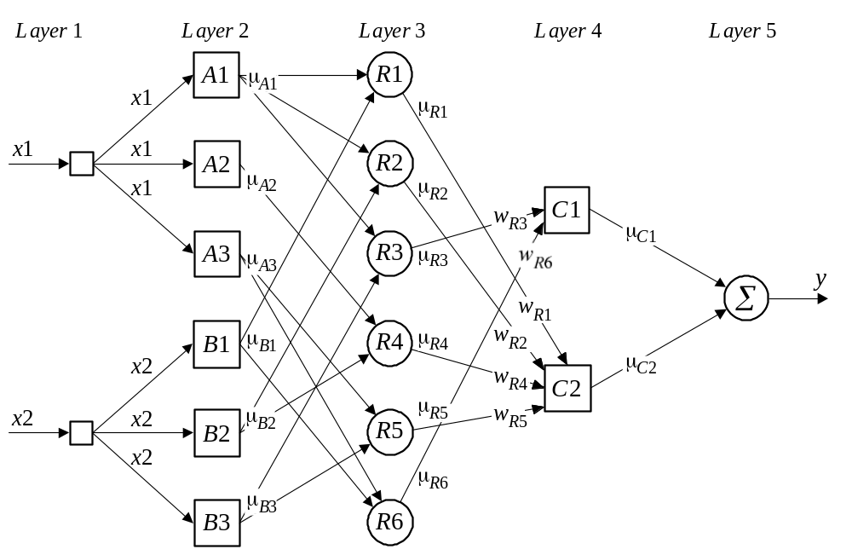
Neuro-fuzzy system
Computer Intelligence and Soft Computing

Slide 23
Each layer in the neuro-fuzzy system is associated with a particular step in the fuzzy inference process.
Layer 1 is the input layer. Each neuron in this layer transmits external crisp signals directly to the next layer.
Layer 2 is the fuzzification layer. Neurons in this layer represent fuzzy sets used in the antecedents of fuzzy rules. A fuzzification neuron receives a crisp input and determines the degree to which this input belongs to the neuron’s fuzzy set.
Computer Intelligence and Soft Computing

Slide 24
We use triangular sets, and therefore, the activation functions for the neurons in Layer 2 are set to the triangular membership functions. A triangular membership function can be specified by two parameters {a, b} as follows:
Computer Intelligence and Soft Computing

Slide 25
Triangular activation functions
Computer Intelligence and Soft Computing

Slide 26
Layer 3 is the fuzzy rule layer. Each neuron in this layer corresponds to a single fuzzy rule. A fuzzy rule neuron receives inputs from the fuzzification neurons that represent fuzzy sets in the rule antecedents. For instance, neuron R1, which corresponds to Rule 1, receives inputs from neurons A1 and B1.
In a neuro-fuzzy system, intersection can be implemented by the product operator. Thus, the output of neuron i in Layer 3 is obtained as:
Computer Intelligence and Soft Computing

Slide 27
Layer 4 is the output membership layer. Neurons in this layer represent fuzzy sets used in the consequent of fuzzy rules.
An output membership neuron combines all its inputs by using the fuzzy operation union. This operation can be implemented by the probabilistic OR. That is,
The value of μ_{C1} represents the integrated firing strength of fuzzy rule neurons R3 and R6
Computer Intelligence and Soft Computing

Slide 28
Layer 5 is the defuzzification layer. Each neuron in this layer represents a single output of the neuro-fuzzy system. It takes the output fuzzy sets clipped by the respective integrated firing strengths and combines them into a single fuzzy set.
Neuro-fuzzy systems can apply standard defuzzification methods, including the centroid technique.
We will use the sum-product composition method.
Computer Intelligence and Soft Computing

Slide 29
The sum-product composition calculates the crisp output as the weighted average of the centroids of all output membership functions. For example, the weighted average of the centroids of the clipped fuzzy sets C1 and C2 is calculated as,
Computer Intelligence and Soft Computing

Slide 30
How does a neuro-fuzzy system learn?
A neuro-fuzzy system is essentially a multi-layer neural network, and thus it can apply standard learning algorithms developed for neural networks, including the back-propagation algorithm.
Computer Intelligence and Soft Computing

Slide 31
When a training input-output example is presented to the system, the back-propagation algorithm computes the system output and compares it with the desired output of the training example.
The error is propagated backwards through the network from the output layer to the input layer. The neuron activation functions are modified as the error is propagated.
To determine the necessary modifications, the back-propagation algorithm differentiates the activation functions of the neurons.
Computer Intelligence and Soft Computing

Slide 32
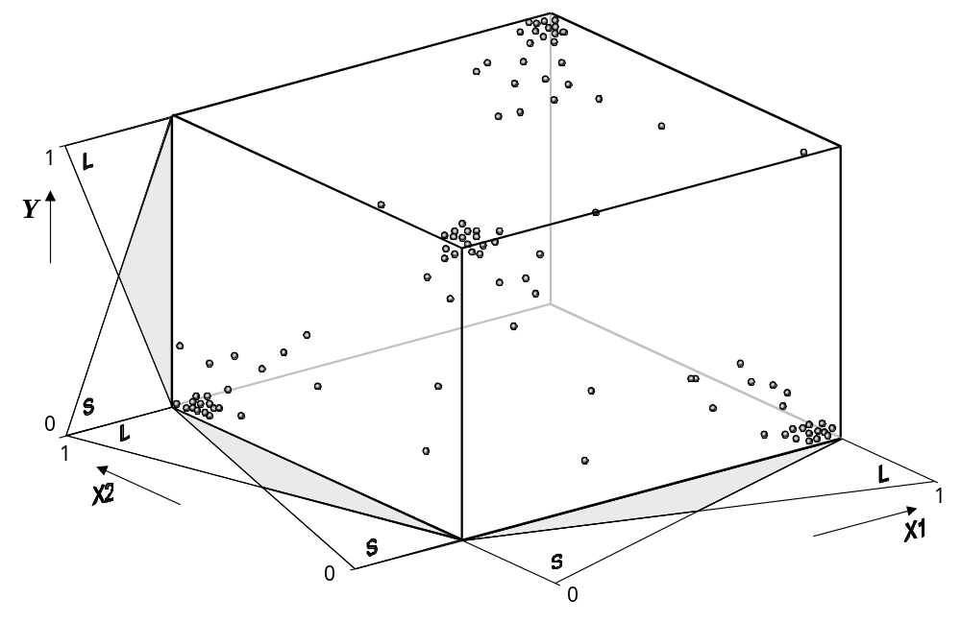
Training patterns
Computer Intelligence and Soft Computing

Slide 33
Given input and output linguistic values, a neuro- fuzzy system can automatically generate a complete set of fuzzy IF-THEN rules.
Let us create the system for the XOR example. This system consists of 2² ∗ 2 = 8 rules. Because expert knowledge is not embodied in the system this time, we set all initial weights between Layer 3 and Layer 4 to 0.5.
After training we can eliminate all rules whose certainty factors are less than some sufficiently small number, say 0.1. As a result, we obtain the same set of four fuzzy IF-THEN rules that represents the XOR operation.
Computer Intelligence and Soft Computing

Slide 34
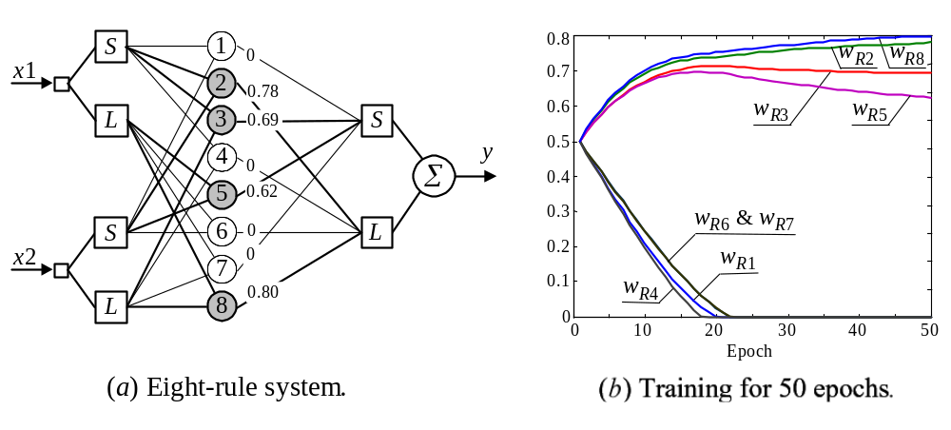
Eight-rule neuro-fuzzy system
Computer Intelligence and Soft Computing

Slide 35
Neuro-fuzzy systems: summary
The combination of fuzzy logic and neural networks constitutes a powerful means for designing intelligent systems.
Domain knowledge can be put into a neuro-fuzzy system by human experts in the form of linguistic variables and fuzzy rules.
When a representative set of examples is available, a neuro-fuzzy system can automatically transform it into a robust set of fuzzy IF-THEN rules, and thereby reduce our dependence on expert knowledge when building intelligent systems.
Computer Intelligence and Soft Computing

